Slide 1
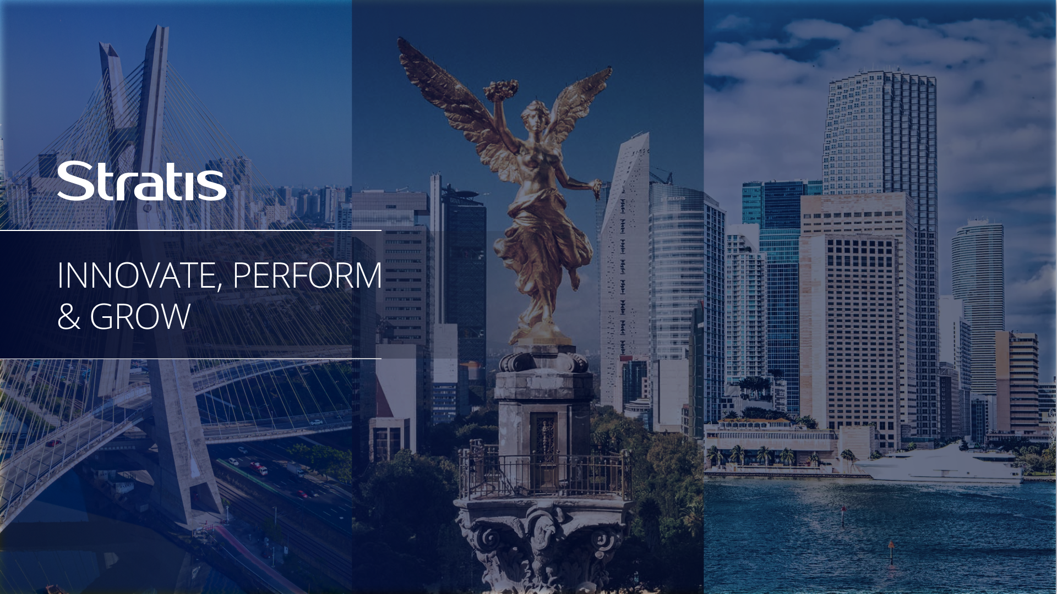
Stratis Tech Nearshoring Services
QA Management Capabilities
Citizens Bank
March 2025
Strategic Impact Solutions, proprietary and confidential for the exclusive use of Strategic Impact Solutions evaluation services for Citizens Bank. The use and reproduction of this material requires the written authorization of Strategic Impact Solutions.

Slide 2
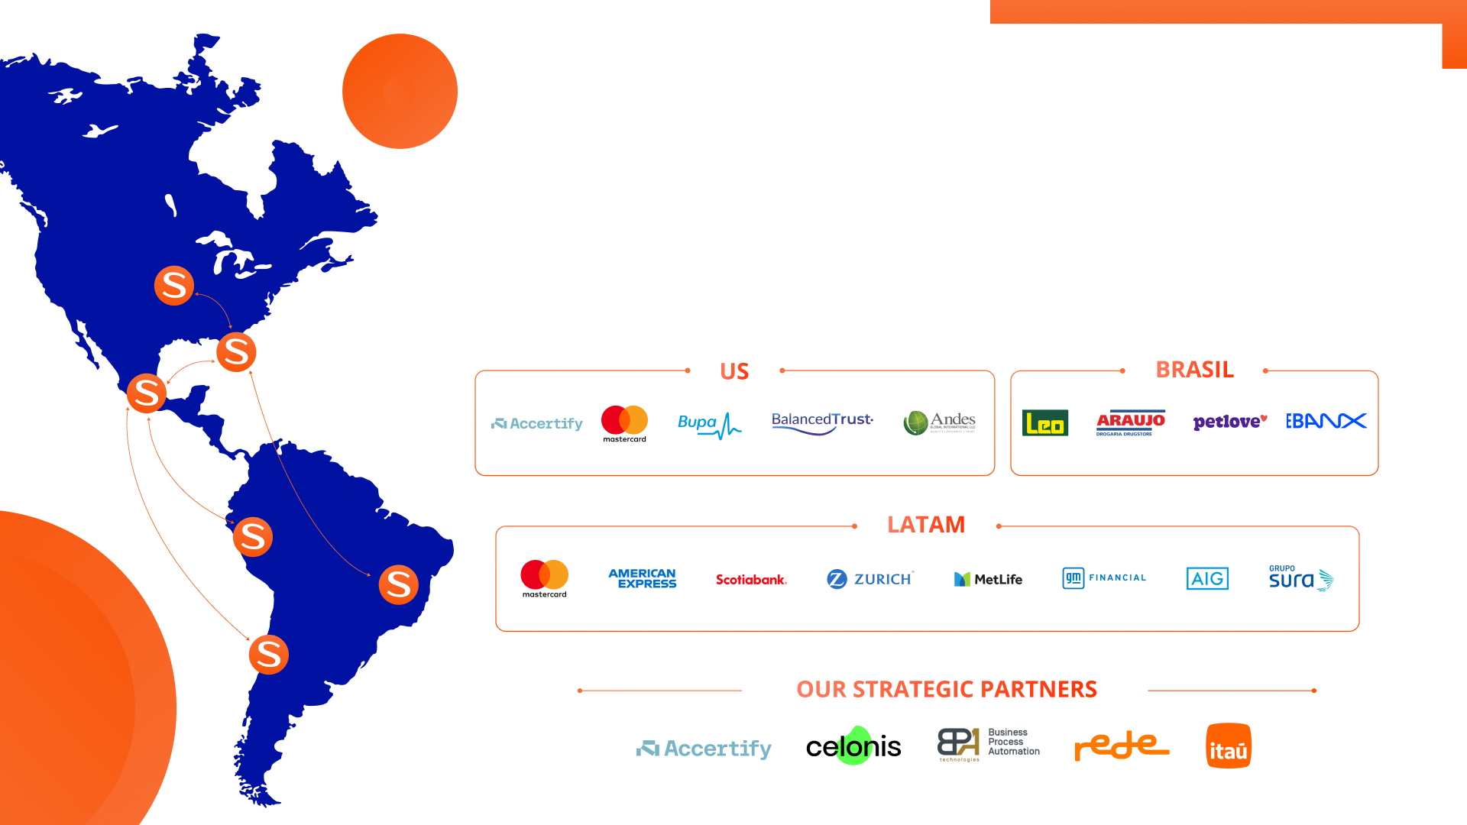
WE ARE STRATIS
Stratis is based in the Americas, with offices in Chicago, Miami, Mexico City, Santiago de Chile, and São Paulo.
Established and specialized, the company has expertise in tech services for banking products. Investing in innovation and employees, Stratis remains flexible and competitive. Partnering with clients, Stratis provides business consulting, digital evolution, and technology project capabilities.
Notes:
Javier 2-5

Slide 3
WE ARE STRATIS
Stratis is based in the Americas, with offices in Chicago, Miami, Mexico City, Santiago de Chile, and São Paulo.
Established and specialized, the company has expertise in tech services for banking products. Investing in innovation and employees, Stratis remains flexible and competitive. Partnering with clients, Stratis provides business consulting, digital evolution, and technology project capabilities.
Notes:
Javier 2-5

Slide 4



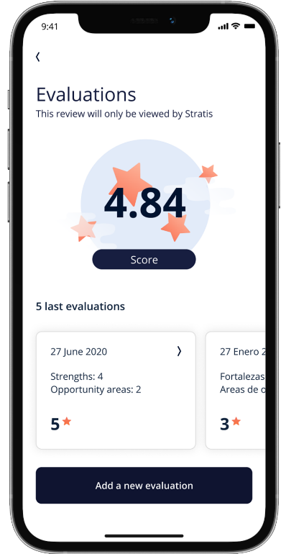
STRATIS FIVE DISTINCTIVES
1
Tailored Recruitment & Selection
Stratis works closely with clients throughout the recruitment process, offering full transparency in our process and ensuring their involvement in key decisions.
2
Talent Performance & Recognition Focus
We facilitate an environment of ongoing talent feedback and recognition, enabling open communication that drives performance improvements, strengthens relationships and reduces bad attrition.
Our core expertise is centered around three key areas: digital transformation, quality assurance and data services tailored for the banking systems landscape.
3
Specialization
4
Boutique Approach
We offer flexible services, customizing each one to meet the specific needs of our clients, with a strong focus on ensuring their business success.
5
Proximity: Nearshore + Local
Our team is nearshore, in the same time zone, culturally close to our clients, and enriched with local talent when needed.
4

Slide 5
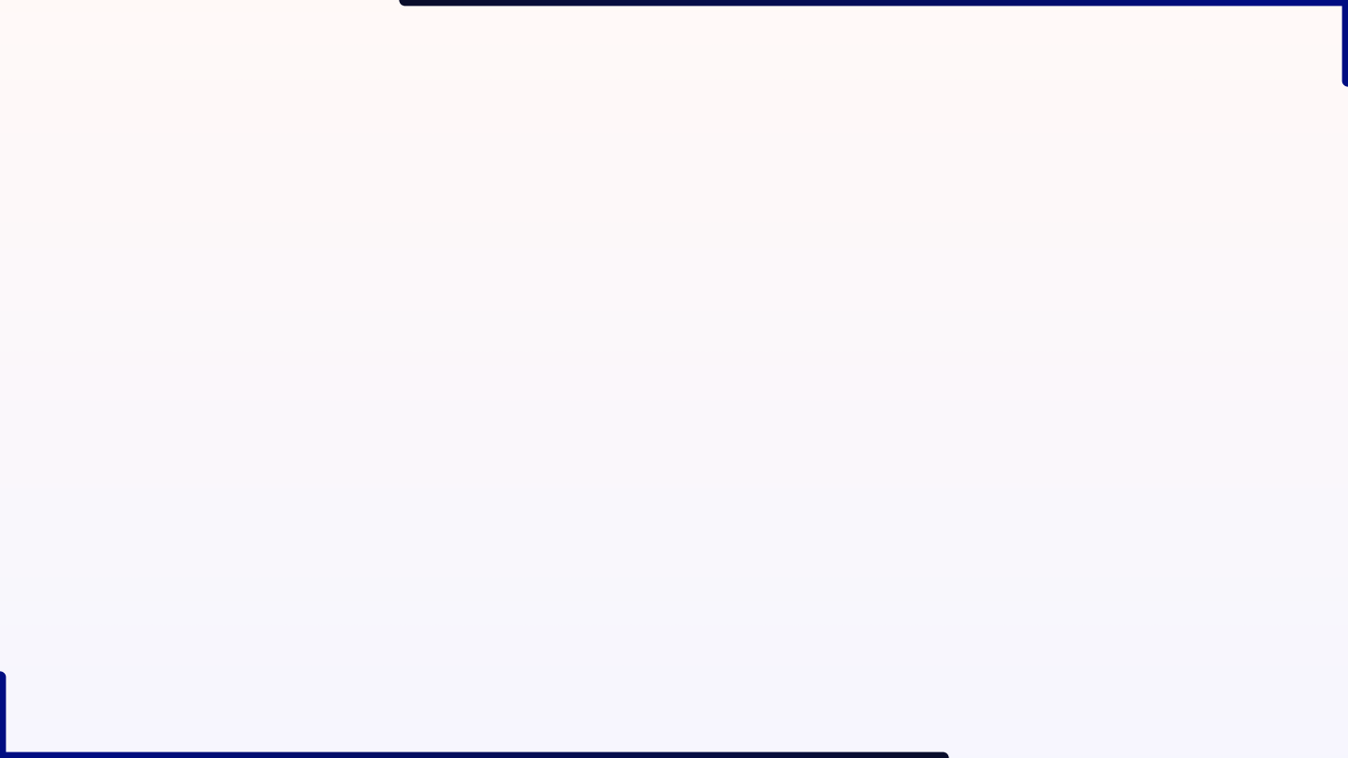
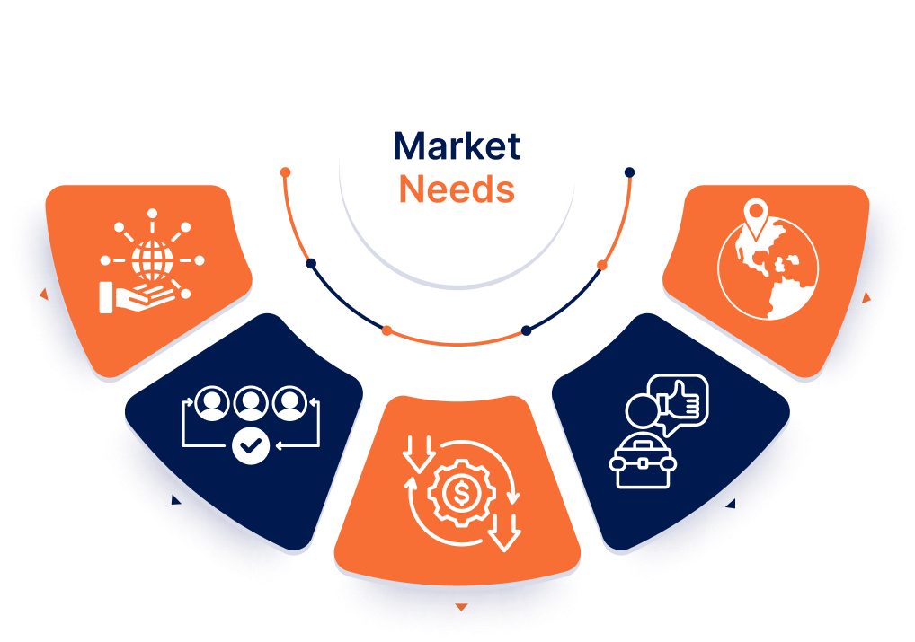
TECH NEARSHORE NEEDS
Organizations need outsourced tech teams & services that meet five core needs:
Expertise:
Provide the necessary tech expertise for the current and future financial landscape.
Geographical and Time Zone Proximity:
Enables effective communication across teams ensuring same time zone
Availability:
Be available when needed, aligned with the variable demand of tech initiatives.
Motivation and Retention:
Stay is not enough; to be motivated and remain on projects long enough to minimize hidden costs from attrition.
Cost-effectiveness:
Offer competitive pricing, lower than local hiring costs and competitive within the nearshore market. Range $26 to $45 USD depending seniority
*

Slide 6




STRATIS PRACTICES
At Stratis, our organizational structure and operational practices are designed to ensure efficiency, adaptability, and value delivery for our clients and talent. Here's an overview of how we are structured and the practices we follow to achieve excellence:
Practices:
1) Data Engineering
2) Digital Transformation
3) QA Engineering
4) Product
Development & CX
5) Business & Tech Consulting
Automation Gap Assessment
Software Testing Lifecycle, deep design, and productivity enhancement
Automation in Selenium and UFT*
Process Intelligence, Improvement, & Management
Digital Evolution
Strategic Business Transformation
Data Visualization
Architecture and ETLs (Extract, Transform, Load)
Analytics and Predictive Models*
Governance
Digital Transformation Architecture (Consulting)
Digital Agile Factory (Execution)
Automation
Customer Needs & Journey
Wireframes & Prototypes
MVPs development / No-Code
6) Stratis Agile
Pods
Agile Management

Slide 7

TESTING MANAGED SERVICES

Slide 8

















STRATIS AGILE QA-AI ENGINEERING
Escaped
Defects
Escaped
Critical Defects
Productivity
Increase*
A
B
< 3%
< 0.2%
20% - 40%
Product + Development
Virtual services and environment management
Stratis Deep Design
Sprint Prep
and Planning
3
Plan &
Estimate
Setup Test
Env.
2
4
Testing Governance Committee
Citizens+Stratis
DAILY
STAND-UP
Exploratory Testing Smoke Tests Functional Testing Non Functional Testing
User Story
Analysis
1
5
Test Execution
Data Management
Sprint
Backlog
Sprint
Task
UAT
System/
Regression testing
RELEASE
7
6
Script Execution, Maintenance
and Optimization
Dev-Sec-Ops: CI/CD for SDLC
(Includes Data and Environment Management)
* Depending on the Automation Adoption Maturity Level.
AGILE KPI MONITORING AND EXECUTION
Notes:
Banking Data: cliente, cuenta, producto dummy con consistencia. CIF (customer info file)
Script Maintenance
Script Production
Script Update
Script Optimization
Quitar 6 Defect Reporting, nos quedamos con 1-7*
7* se llama UAT, en lugar de UTA
4, 5 y 6* quedan dentro de una caja llamada

Slide 9







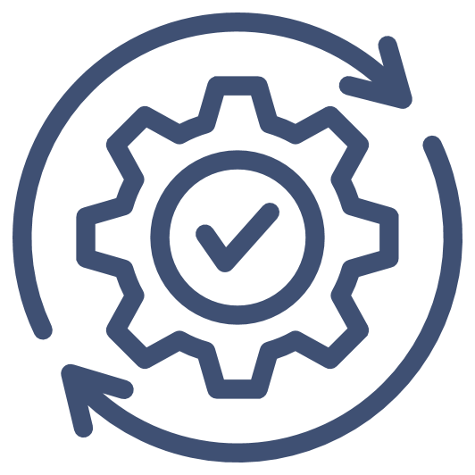









STRATIS DEEP DESIGN METHODOLOGY
Critical/High
Stratis Deep Design
Tech Lead
SME
Product + Development
Staggered Review
TC structure audit
Full Coverage
Feedback and approval
User Stories
Tester + AI Models
Test Cases
Test Cases +
AI Models
Automation Scripts
Automator
Large/Complex scenarios:
Single epic
Parallelism within same sprint
Multiple sprints
Designed Test Cases
Defects Found in QA
Defects in Production
How this helps your business:
Low
Medium
Better reputation via fewer defects
Faster Time to Market
Save Time, Money & Efforts
Notes:
Flujo 1:
Tester recibe User Stories y trabaja con Producto y Desarrollo para auditar los requerimientos y asegurarse que sean consistentes. Después se alimentan a los modelos de IA y esta va a entregar Test Cases, los cuales pasarán a Deep Design.
Flujo 2:
Test Cases auditados se alimentan al AI y esta a su vez entrega Scripts de Automatización los cuales van a pasar por una última auditoria y ajuste.
Better company image through fewer defects
Confianza a través de la cooperación humano + AI

Slide 10

BANKING SYSTEMS DELIVERY MODEL OPPORTUNITIES ENVIRONMENT AND DATA CHALLENGES
Banking Channels and Satellite Systems
Banking System
Reconciliation
Processes
Enterprise Data Lake
All the Banking and Non Banking Master Data
Ledger daily Operation
Operational Data (Txns, etc)
STAGING
Data consolidation
CIF
Deposits
Loans
DB
Data Marts
Product Accounting
Subsidiaries
Regulatory
Reports
Finance
Reports
Operational
Reports
Provisioning
WM
Ledger
Data
General Ledger
BASEL, etc
Others
Operational Data
Operational & “Regulatory Reports”
Legacy/Core
Components
ETL for GL and Central repositories
DWH, MIS & Data Mgmt
Testing Environments Design: Due to the complexity of the the current IT ecosystem, its very important to design the Testing Platform baselibe, attending the appropriate computing capabilities needs: Design & Validate all the computing capabilities like storage, CPU and memory to fullfill the Functional and Non functional test approach.
Dummy Banking Testing Data: There are several needs to generate data across all the ecosystem to support the Funcional and NFT reqs (CIF-Products-Accounts), balances, etc.
Reconciliation Method : Confirm into the use cases that the systems already have the appropriate operational reconciliation models, including GL, etc,.
Transactional Integrity and Traceability: Customize de environment and the Data to validate the E2E transactional and Data integrity and traceability.
Transaction Integrity: The Legacy/Core systems do not consider rules depending if the satellite sends or receives monetary txns.
Transaction massive operation: NFT design – validating the overall capabilities to support high demand transactional requirements
File Transfer massive Operation: how to replicate the most important Files to execute the best File Test Cases.
Data Life Cycle: Overall there are several needs to accomplish the data life cycle already defined by the Final users.
Confidential

Slide 11
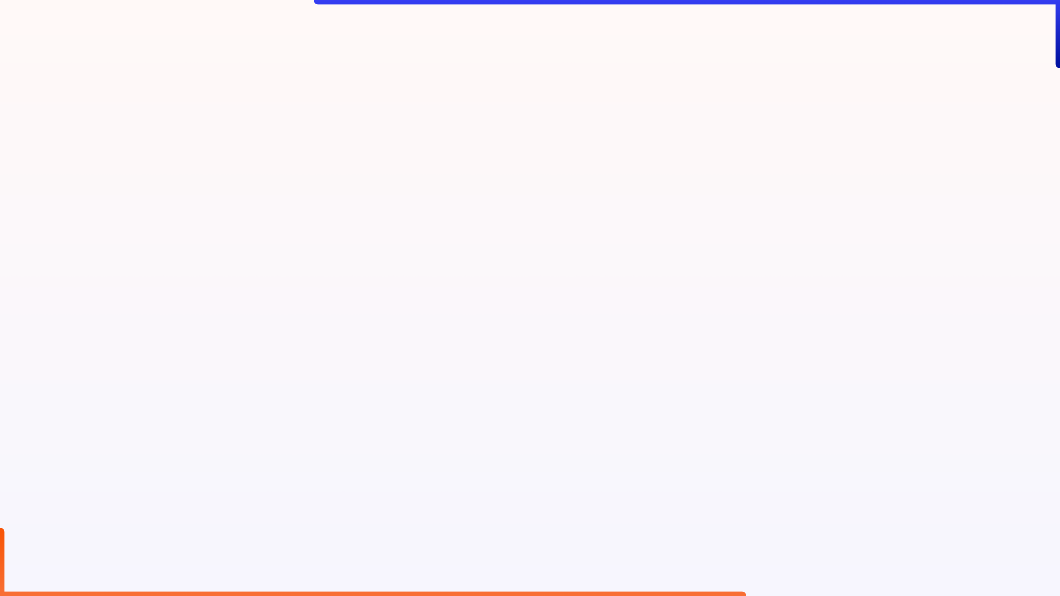
QA AGILE USING AI
Stage | QA Activity | Tools
Backlog Refinement | Use GenAI to suggest test cases from acceptance criteria or user story descriptions. | GitHub Copilot (for test case drafts), Atlassian Suite
Sprint Planning | Auto-generate initial test cases and automation templates. | Copilot, GitHub Copilot, Atlassian Suite
Development | Write unit tests, API tests, and UI test scripts with Copilot assistance. | GitHub Copilot, Atlassian Suite
Continuous Testing | Automate and run tests in CI/CD, automatically fix minor test failures with AI. | GitHub, Jenkins, GitHub Copilot, Bitbucket, Selenium, UFT, Gherkin, Atlassian Suite
Exploratory Testing | Use AI to generate random, high-risk test scenarios for manual testing. | GitHub Copilot (scenario generation), Postman, Load Runner, Atlassian Suite
Sprint Review | Validate acceptance criteria, run AI-optimized regression tests. | Postman, GitHub Copilot, Atlassian Suite
Release | Conduct AI-powered test generation for last-minute checks, monitor production. | GitHub Copilot, Atlassian Suite

Slide 12

HOW CAN STRATIS HELP CITIZENS BANK?
Stratis combines deep expertise in banking, technology, and consulting with flexible staffing and nearshoring solutions to accelerate Citizens Bank's digital transformation. By leveraging our specialized talent and nearshore capabilities, we enable Citizens Bank to innovate faster, reduce costs, and maintain a competitive edge.
QA AI Engineering:
Enhance Quality and Productivity
Open to make a proposal that will ensure:
Progressive productivity increase
Time savings: 20-60%*
Productivity increase between 20%-40%*
Increase in cost efficiency: 10%-35%+
After our set up curve DER for critical defects= .2%; overall, DER < 3%
AI integrated for achieving increased productivity
Reduce scripts automation Backlog
Ready to subcontract Indian SME capacity/become subcontracted through a Citizen Bank’s vendor
* Depending on the Automation Adoption Maturity Level

Slide 13
SUMMARY
Citizens Bank provided an overview of their Testing Center of Excellence.
Aggressive automation strategy with a shift-left focus.
90% test case automation rate and 38% testing cycle-time reduction leading to $10m USD in savings.
Aiming to reduce escaped defects by expanding test coverage and addressing Test Data/Environment Management issues.
Stratis presented their end-to-end testing practice which leverages two key components:
A “Deep Design” methodology which has led to an Escaped Defect rate in Production < 3% with no Critical/High bugs within the past year.
Artificial Intelligence Models that can great increase team productivity by reducing execution time, specifically when generating Test Cases, Test Data and Automation Scripts.
Additionally, a banking systems delivery model was presented by Stratis, highlighting key environment and data challenges found commonly in Financial Institutions similar to Citizens Bank.
Stratis provided target progressive productivity gains :
Time savings: 20-60%*.
Productivity increase between 20%-40%*.
Increase in cost efficiency: 10%-35%+.
Stratis is willing to invest in generating the SME capability at no cost to Citizens Bank.
There is certain overlap in expertise, and this should be explored further.
Stratis will send out presentation material and look for a follow-up call.

Slide 14
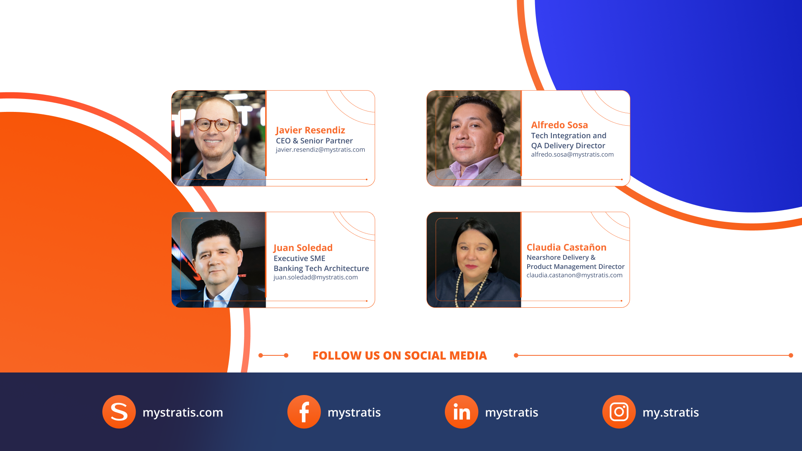
OUR TEAM

Slide 15


